Slide 1
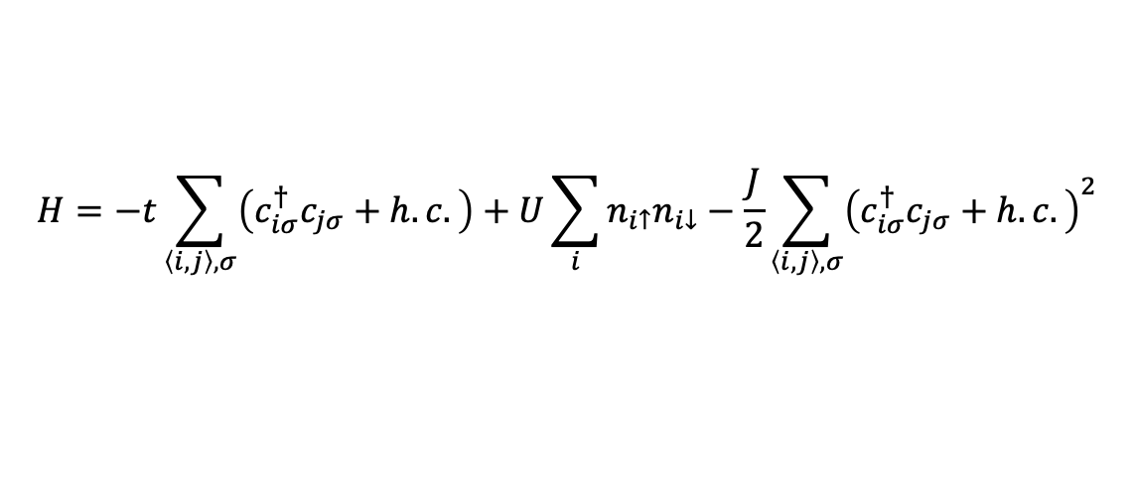
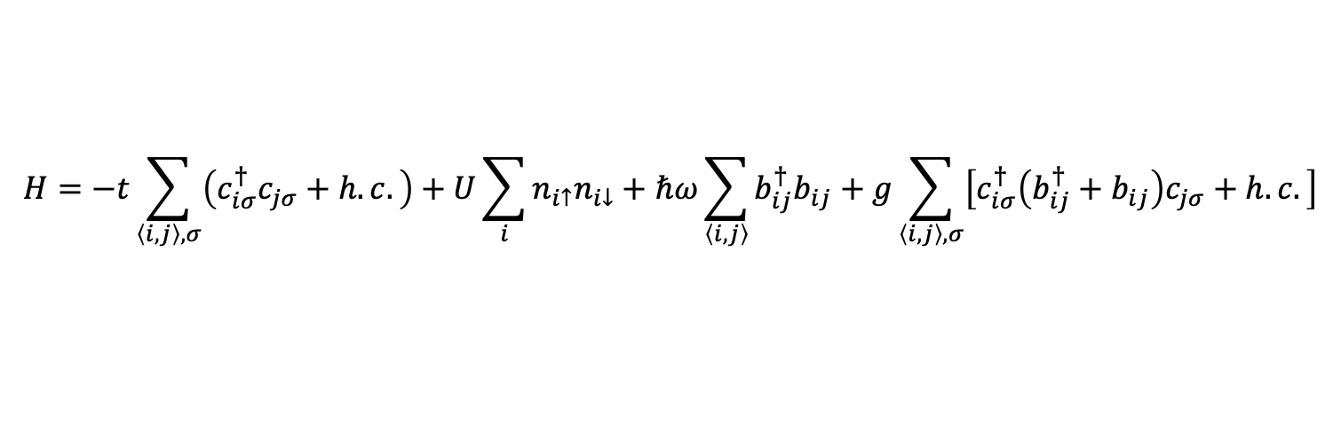
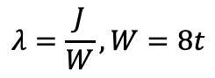
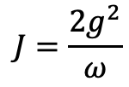
SSH-Hubbard model
$$H=−t\sum_{\left\langle i,j\right\rangle ,σ}{\left(c_{iσ}^{†}c_{jσ}+h.c.\right)}+U\sum_{i}{n_{i↑}n_{i↓}}+ℏω\sum_{\left\langle i, j\right\rangle }{b_{ij}^{†}b_{ij}}+g\sum_{\left\langle i, j\right\rangle ,σ}{\left[c_{iσ}^{†}\left(b_{ij}^{†}+b_{ij}\right)c_{jσ}+h.c.\right]}$$
$$H=−t\sum_{\left\langle i,j\right\rangle ,σ}{\left(c_{iσ}^{†}c_{jσ}+h.c.\right)}+U\sum_{i}{n_{i↑}n_{i↓}}−\frac{J}{2}\sum_{\left\langle i,j\right\rangle ,σ}{{\left(c_{iσ}^{†}c_{jσ}+h.c.\right)}^{2}}$$
$$J=\frac{2g^{2}}{ω}$$
$$λ=\frac{J}{W}, W=8t$$

Slide 2
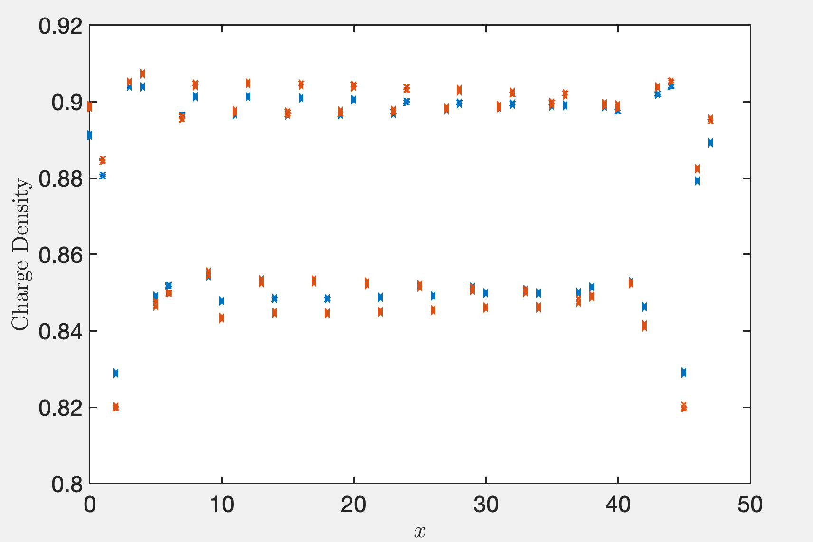
Lambda = 0.3, 0.4

Slide 3
Truncation error (1e-6), extract from the middle bond
Lx\D | 8000 | 9000 | 10000 | 12000 | 13000 | 14000 | 15000 | 16000 | 17000 | 18000 | 20000
16 | 3.37 |  | 2.82 | 2.45 |  | 2.18
24 | 3.44 |  | 2.79 | 2.41 |  | 2.17 |  | 2.00
32 | 3.70 |  | 2.96 | 2.61 |  | 2.27 |  | 2.07 | 1.97
40 | 3.49 |  | 2.88 | 2.47 |  | 2.19 | 2.03 | 1.96 | 1.85
48 | 3.16 |  | 2.67 | 2.34 |  | 2.08 |  | 1.92 |  | 1.78 | 1.47
I recalculated Lx = 48 on D = 8000. The energy value is lower than before by at least 0.02. The state of Lx=48 we get previously may be trapped to local minimum thus the correlation may not right.

Slide 4
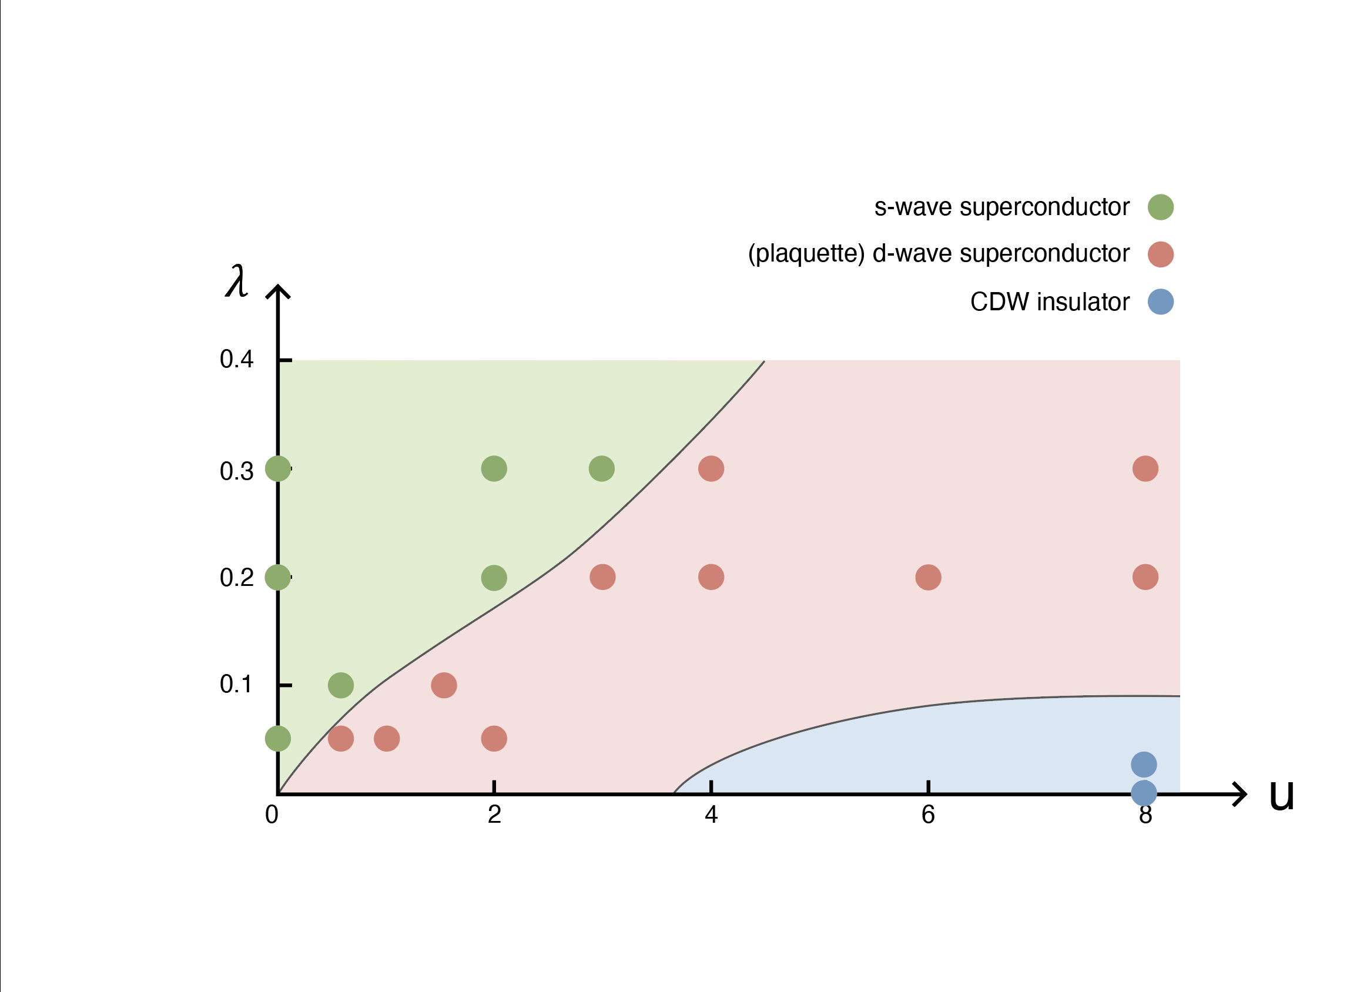
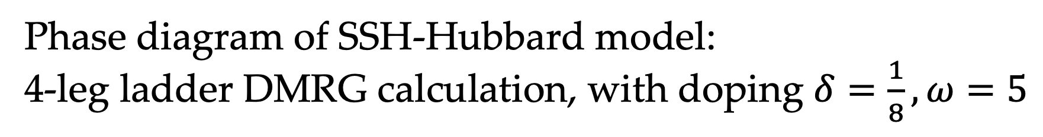
Phase diagram of SSH-Hubbard model: 4-leg ladder DMRG calculation, with doping $δ=\frac{1}{8},ω=5$

Slide 5
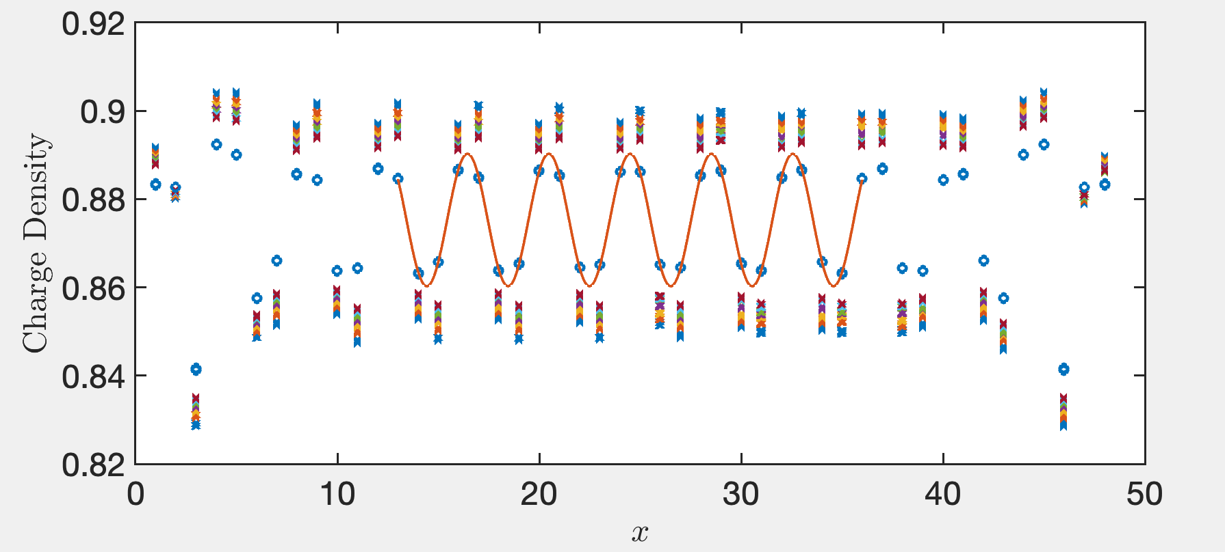
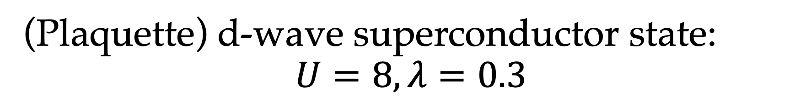
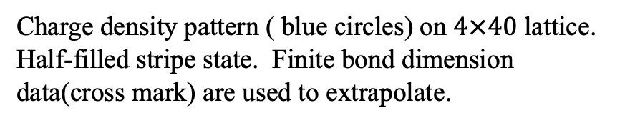
(Plaquette) d-wave superconductor state: $$U=8, λ=0.3$$
Charge density pattern ( blue circles) on $4×40$ lattice. Half-filled stripe state. Finite bond dimension data(cross mark) are used to extrapolate.

Slide 6
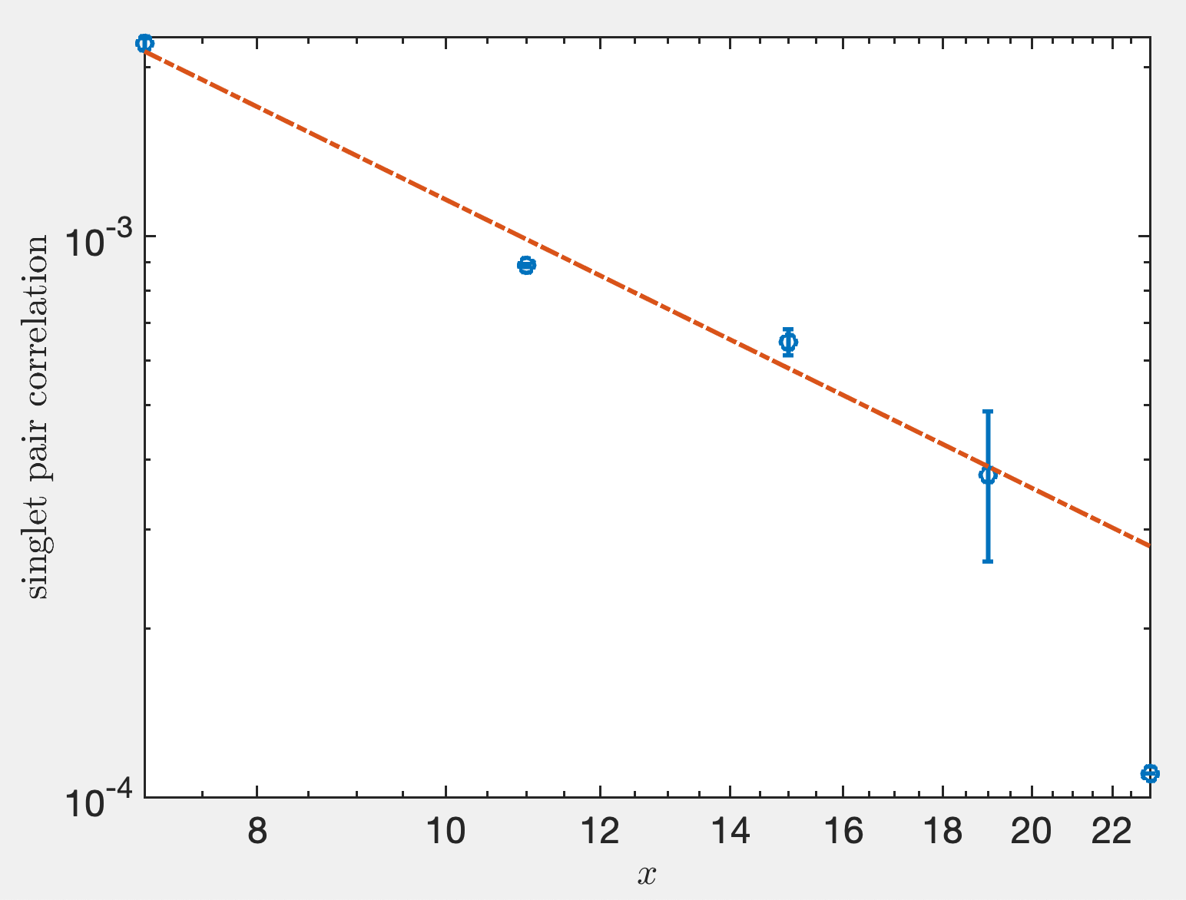
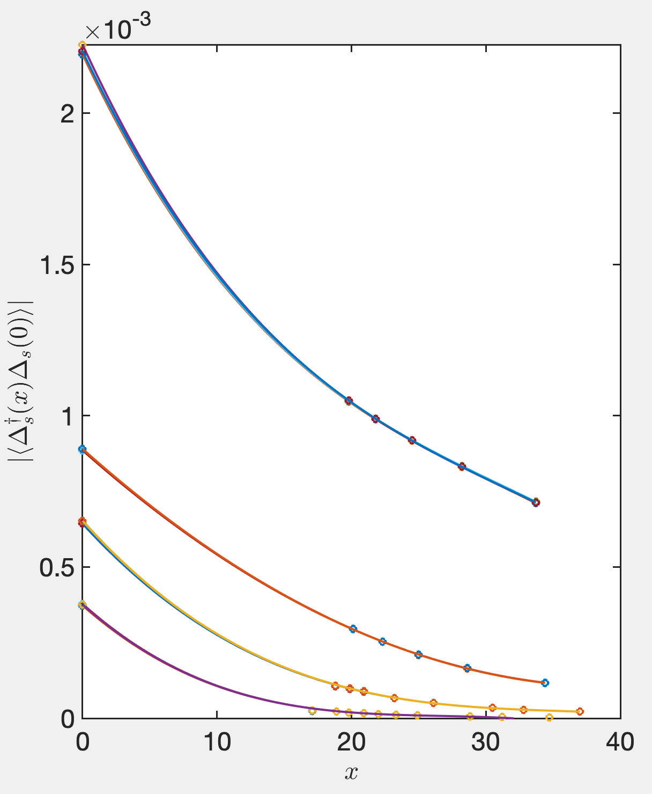
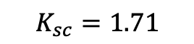
superconductor correlation(cubic extrapolation)
We use cubic functions to extrapolate
$$K_{sc}=1.71$$
Notes:
这里其实包含了相当大artificial的成分

Slide 7
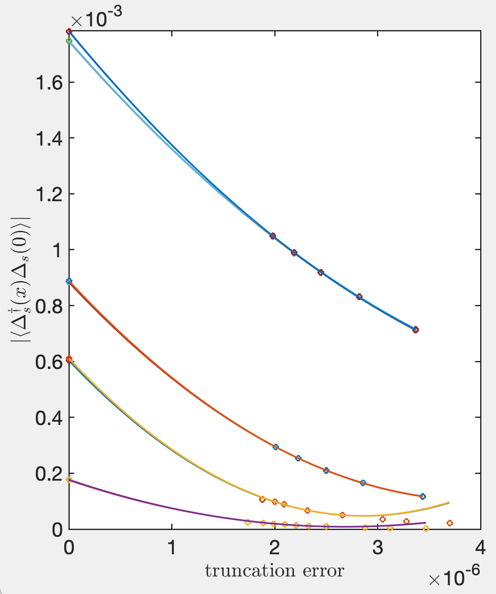
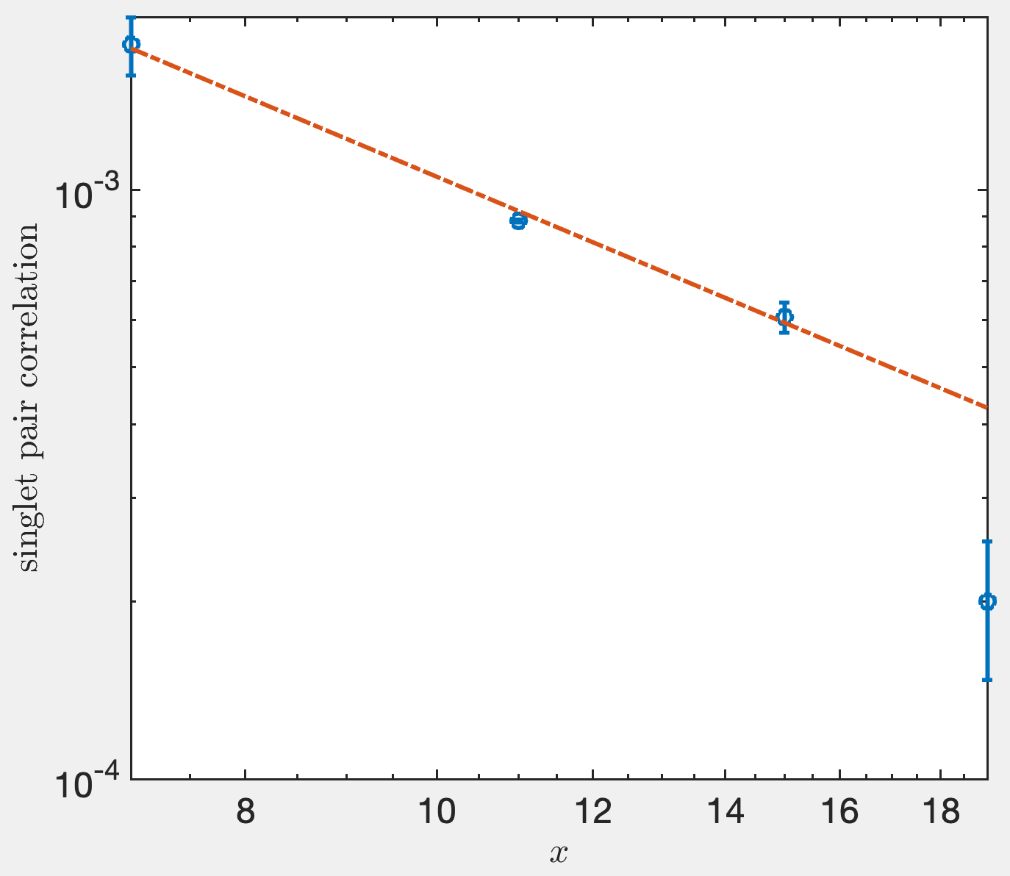
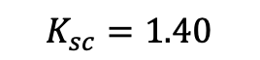
superconductor correlation
We use quatric functions to extrapolate
$$K_{sc}=1.40$$
Notes:
这里其实包含了相当大artificial的成分

Slide 8
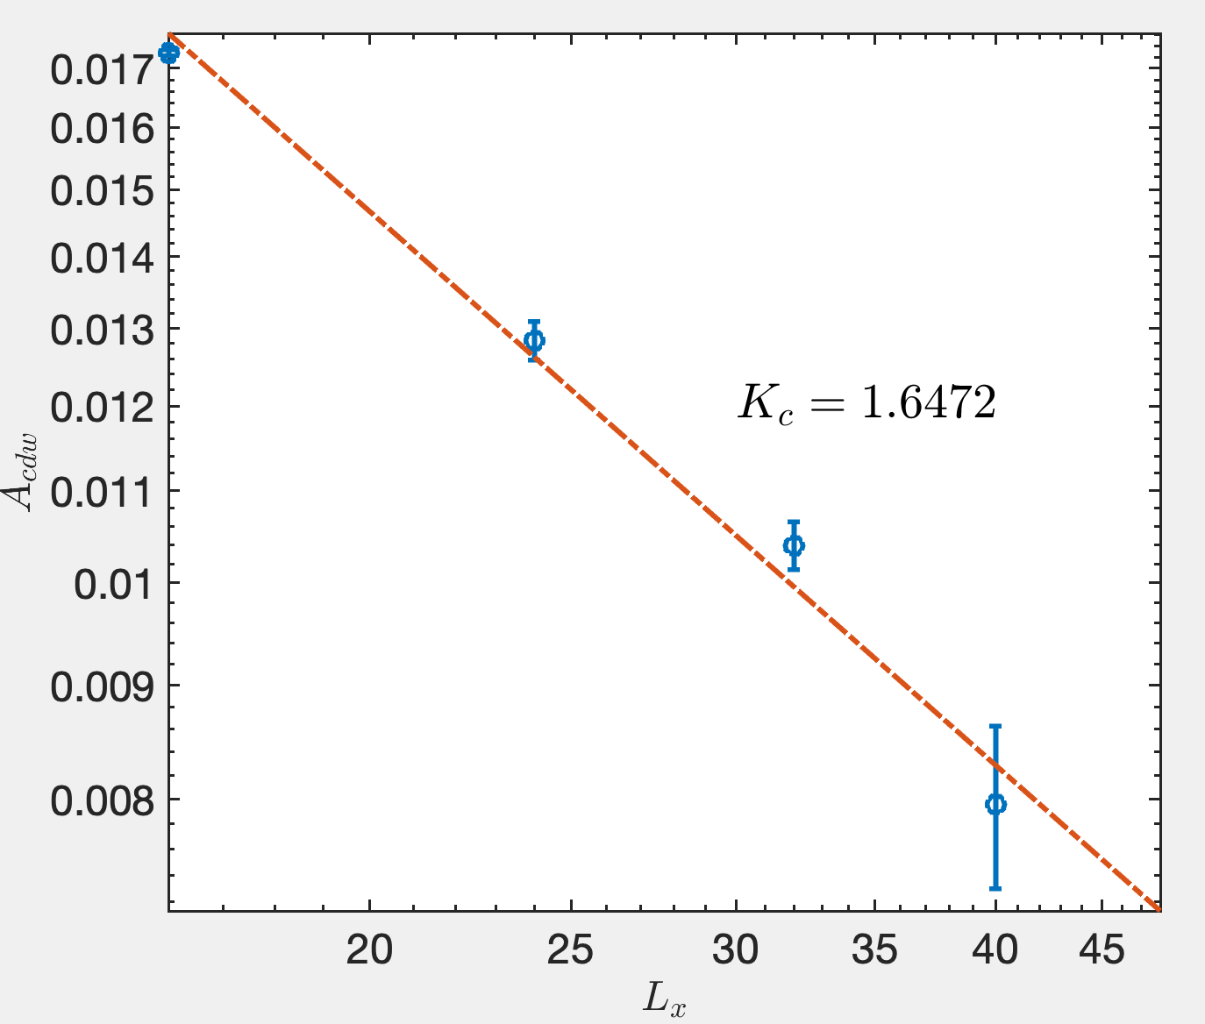
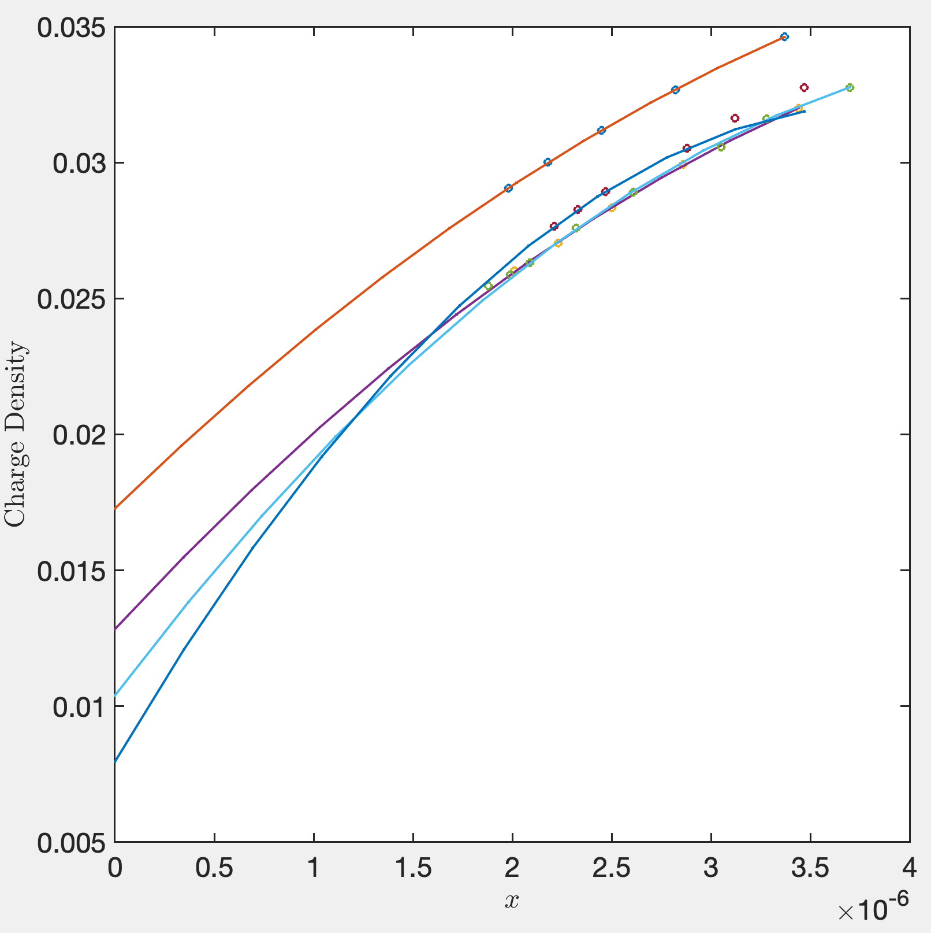

Fit $K_{c}$ from $A_{cdw}$
We use quadratic extrapolation

Slide 9
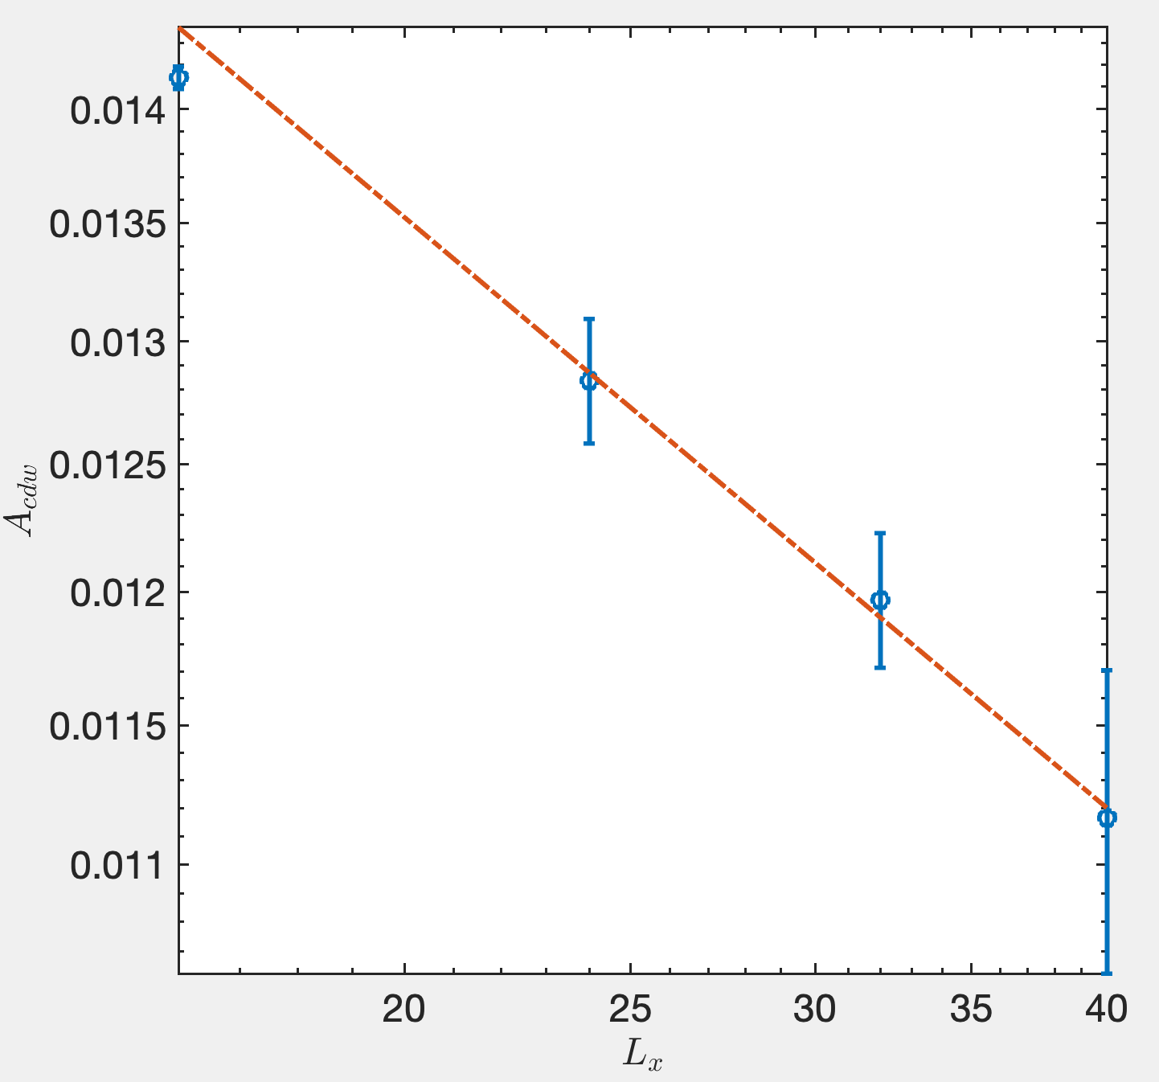
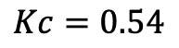
Fit $K_{c}$ from $A_{cdw}$
We use quadratic extrapolation
$$Kc=0.54$$

Slide 10
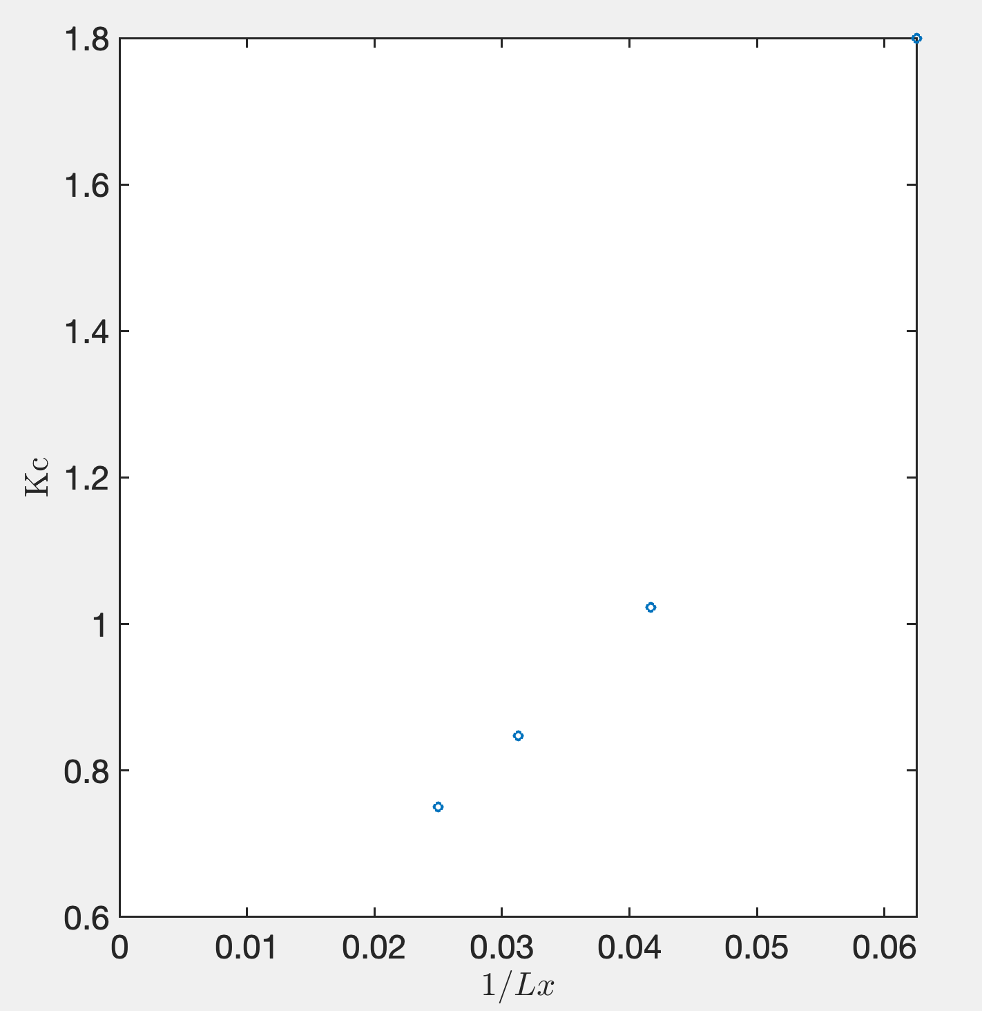
Friedel Oscillation

Slide 11
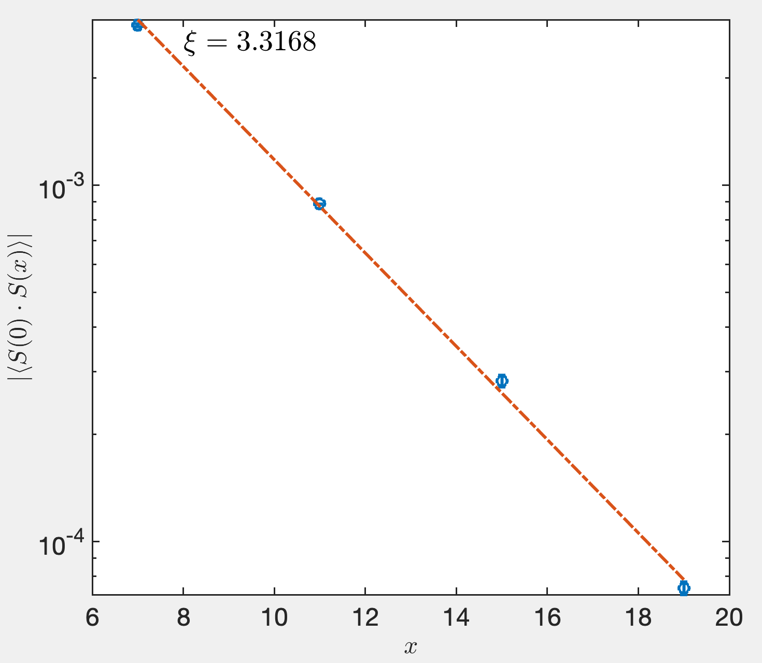
Spin correlation

Slide 12
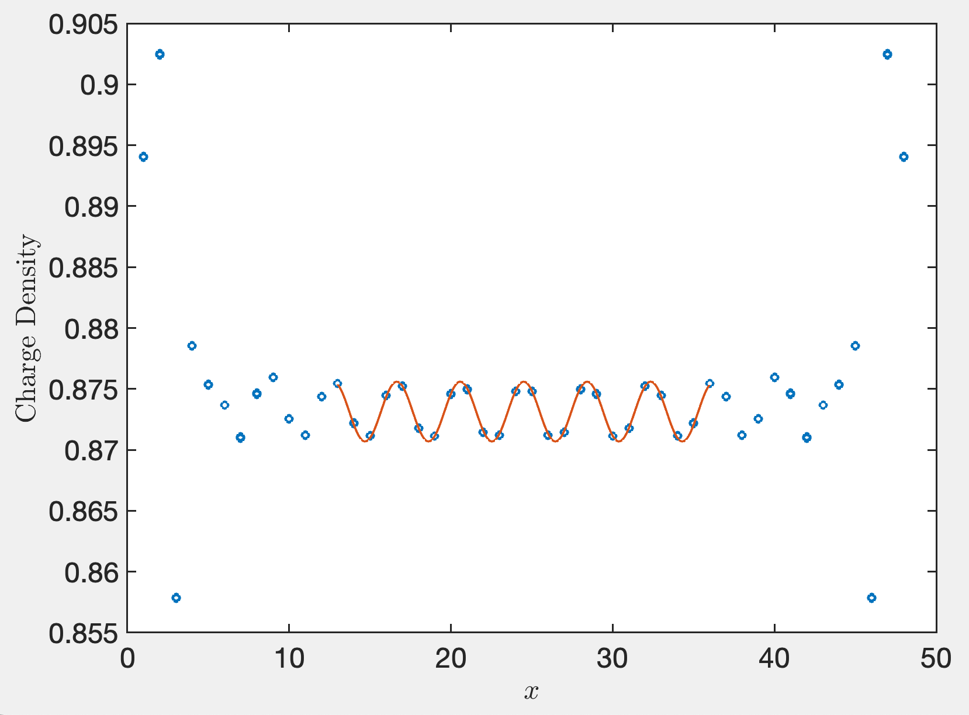
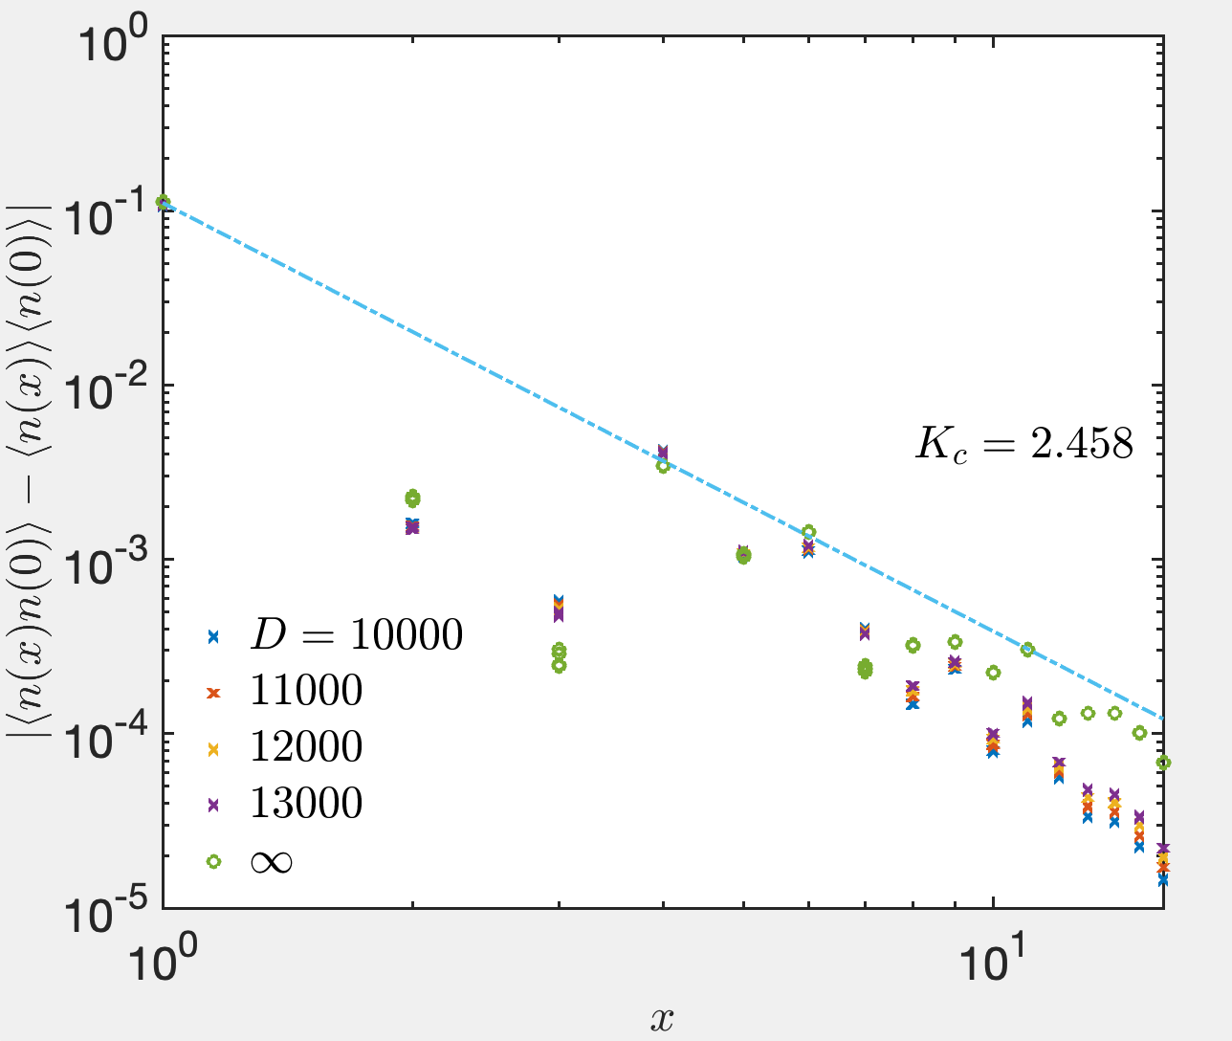
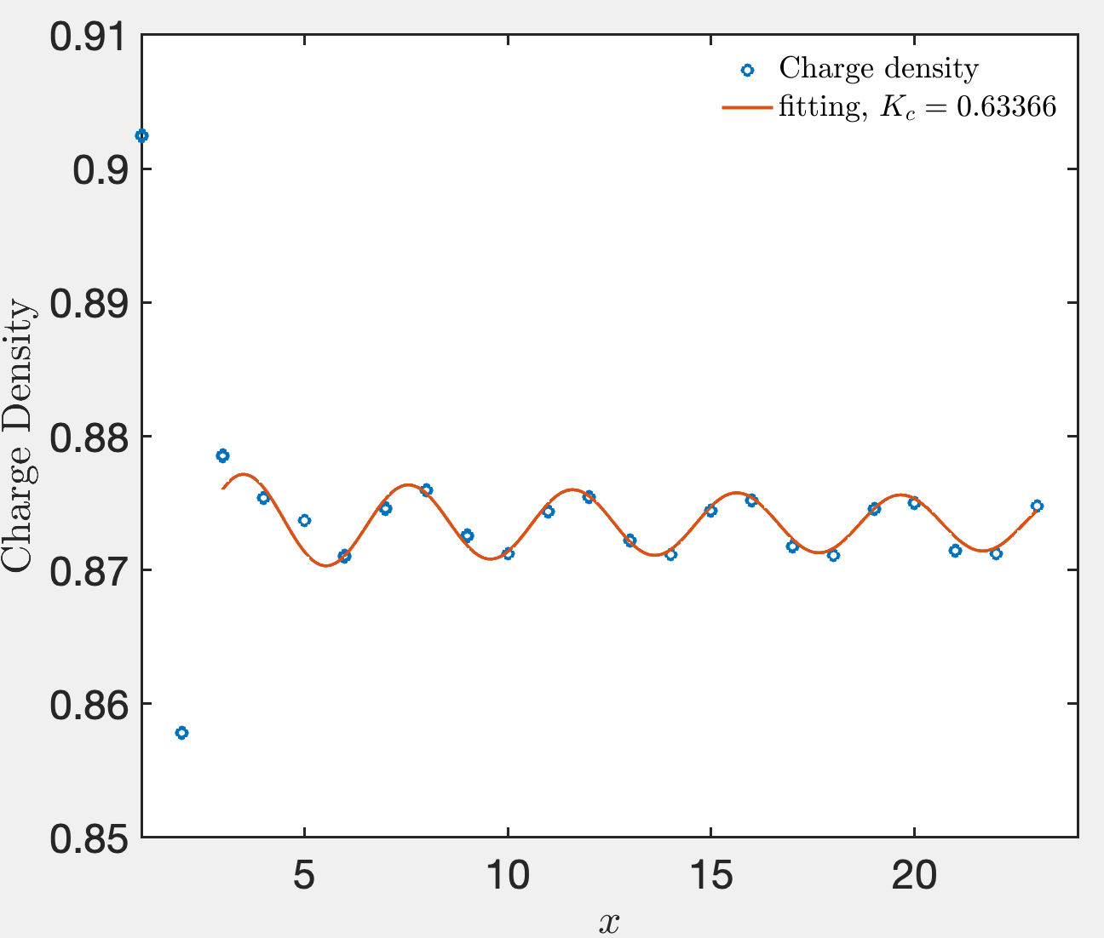
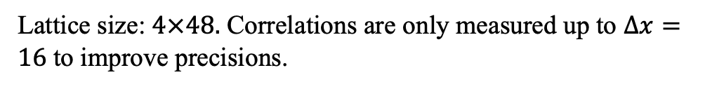
s-wave superconductor state: $U=0, λ=0.3$
Lattice size: $4×48.$ Correlations are only measured up to $Δx=16$ to improve precisions.

Slide 13
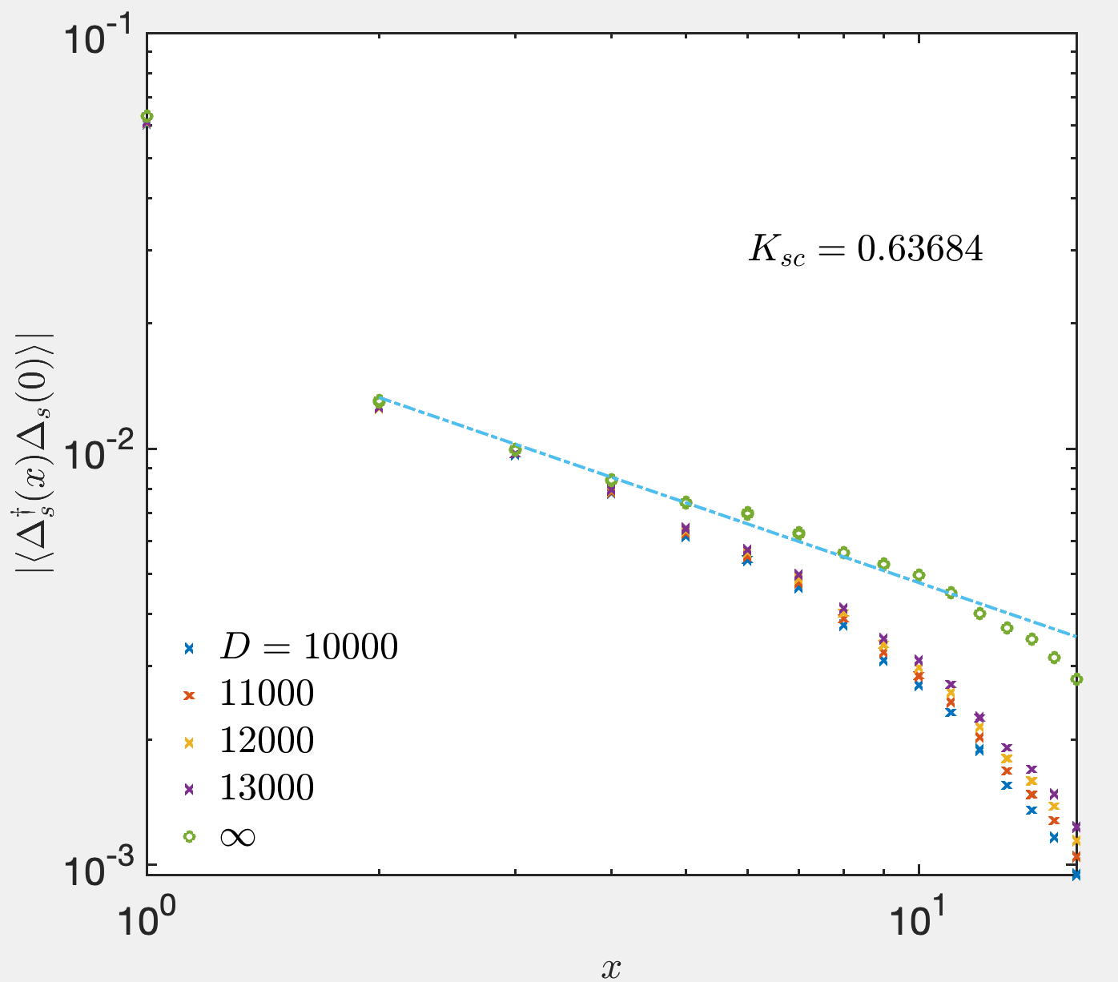
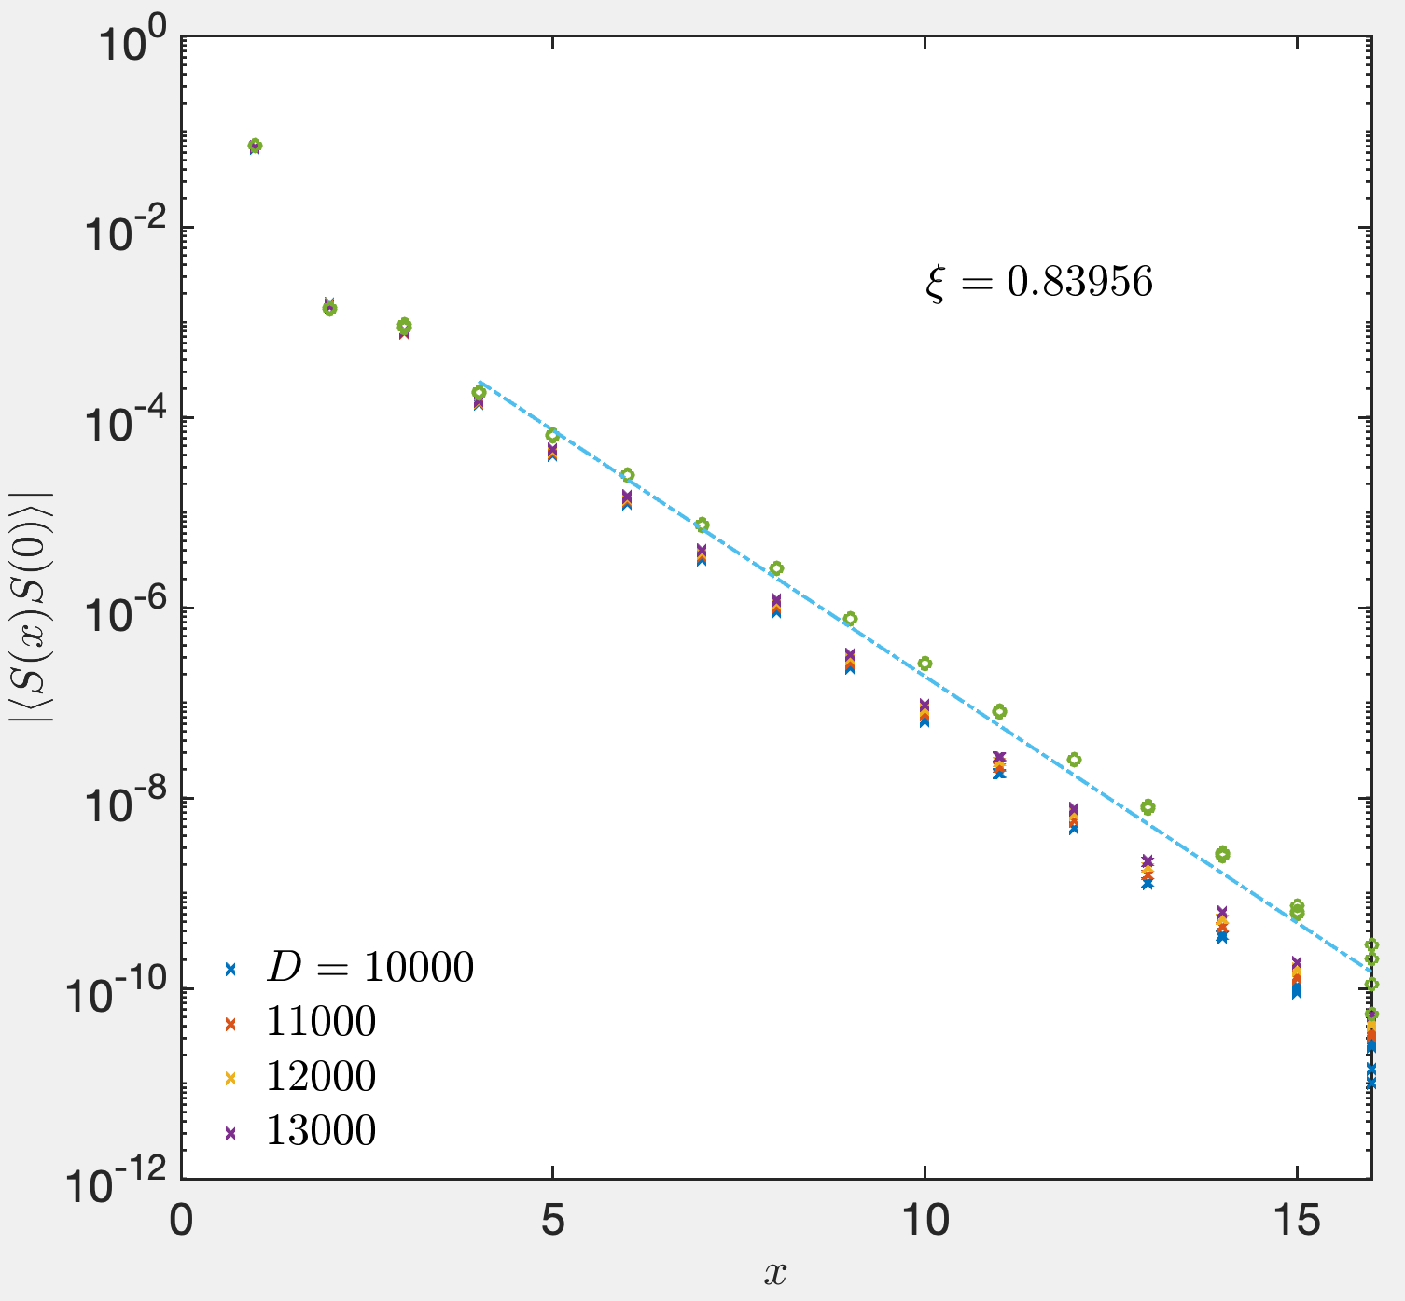

Slide 14
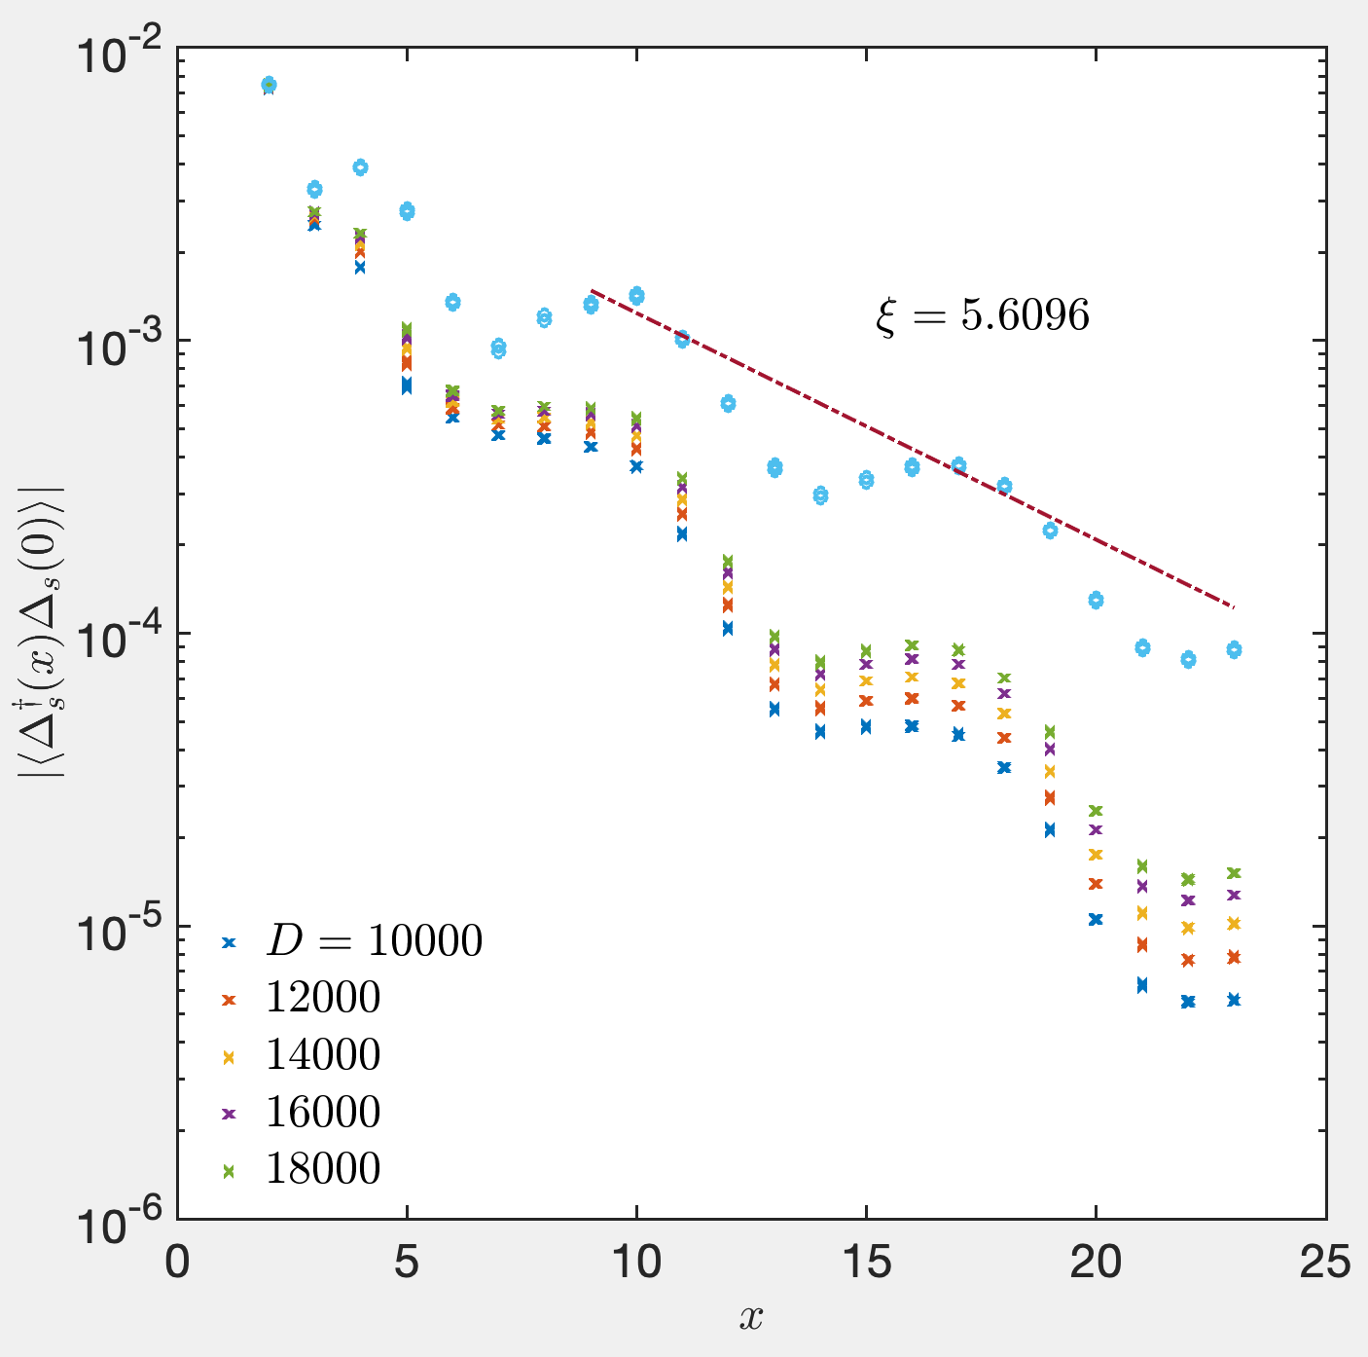
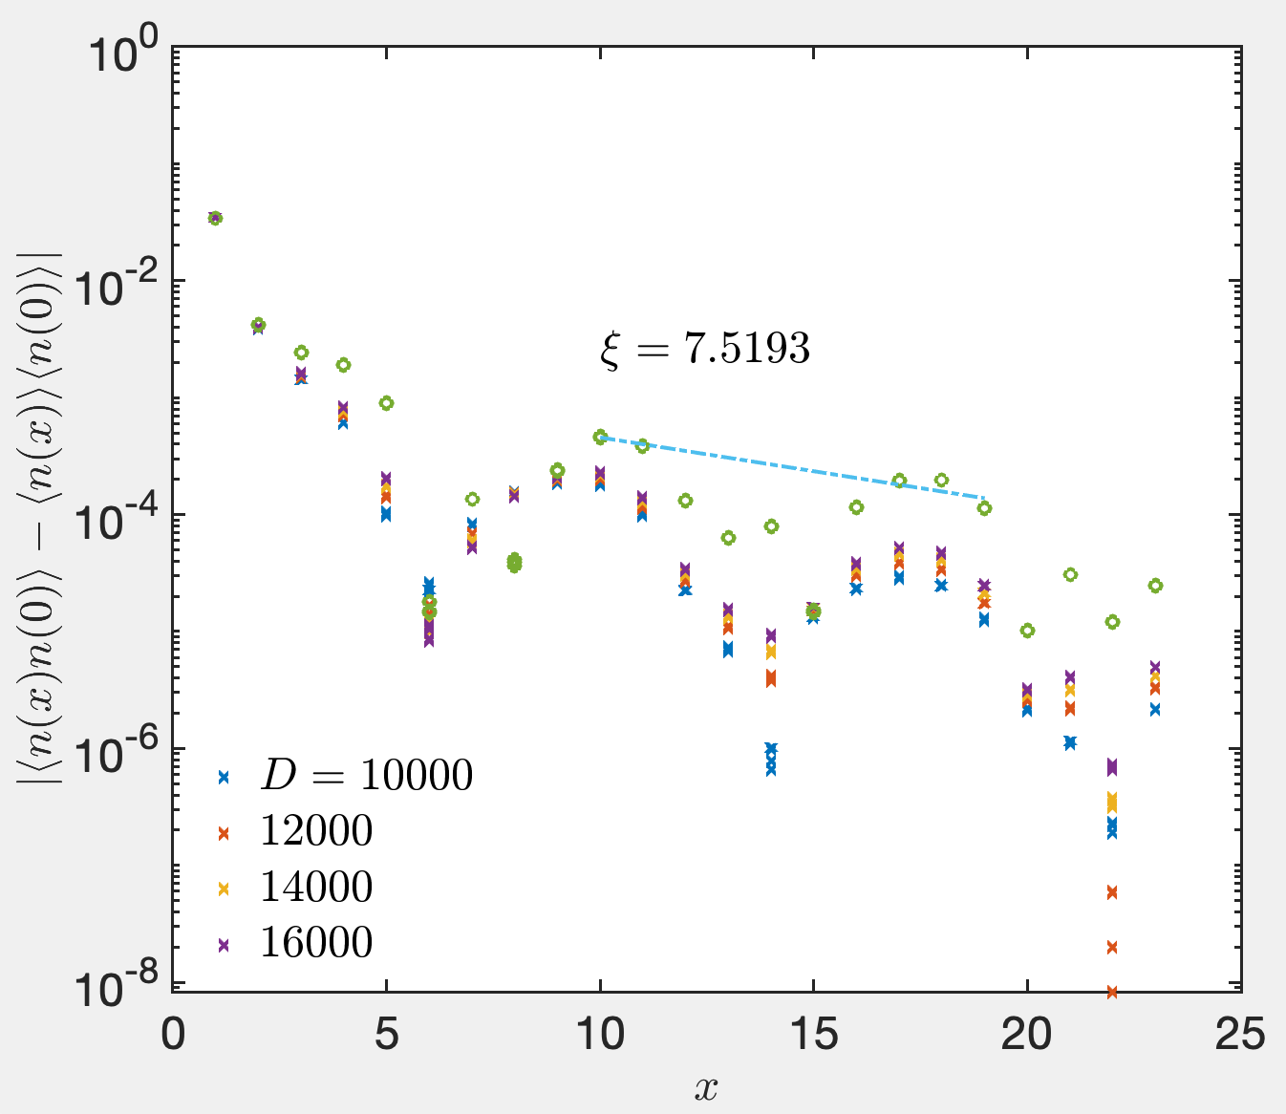
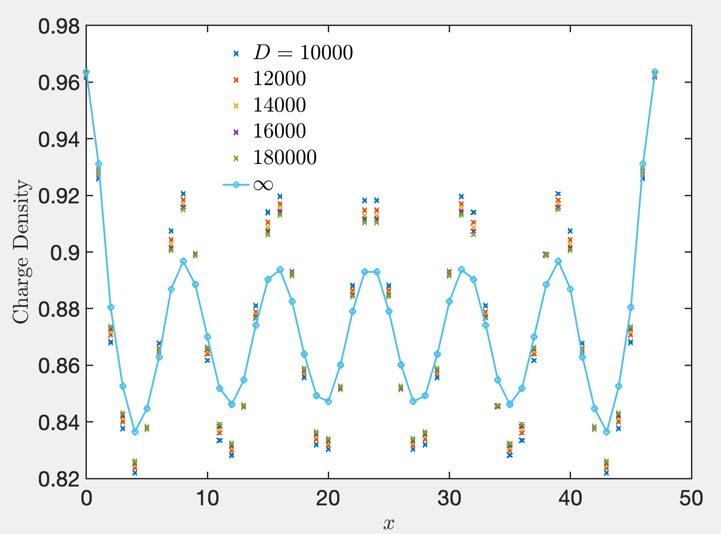

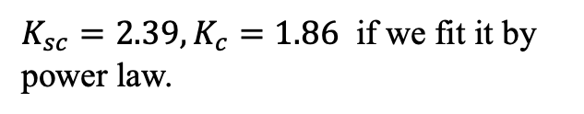
filled-stripe CDW state: $U=8, λ=0.01$
(We have symmetrized the data at finite bond dimension here.)
$K_{sc}=2.39, K_{c}=1.86$ if we fit it by power law.

Slide 16
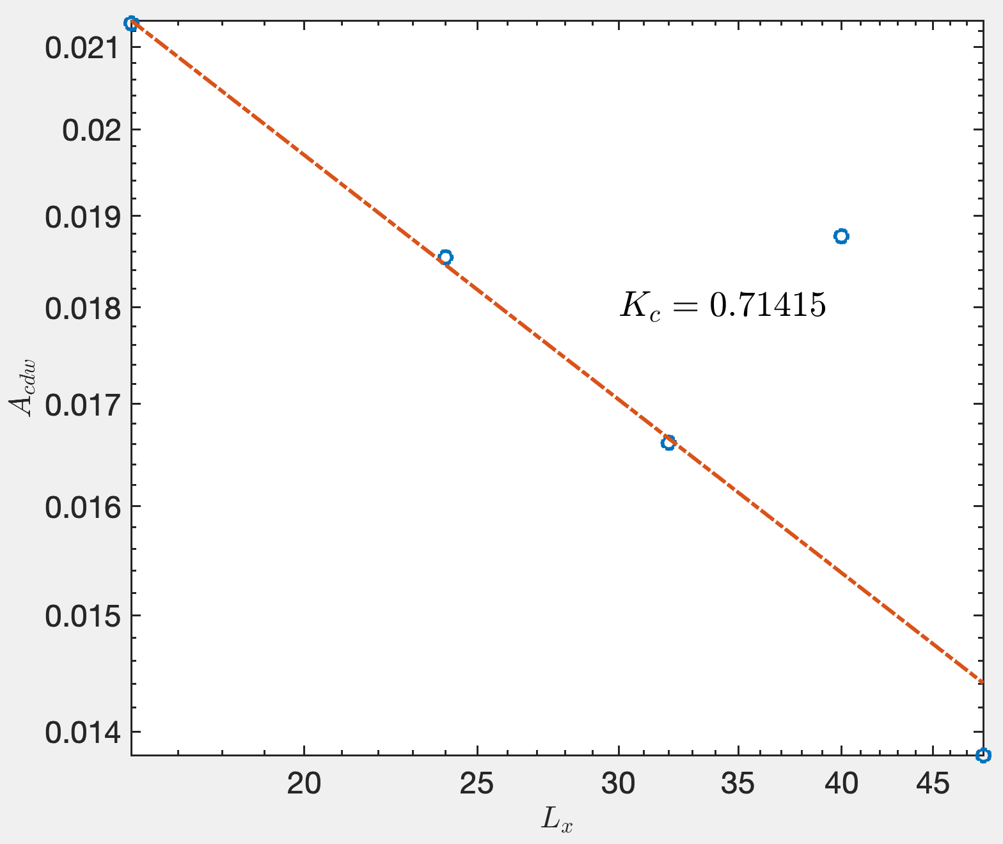
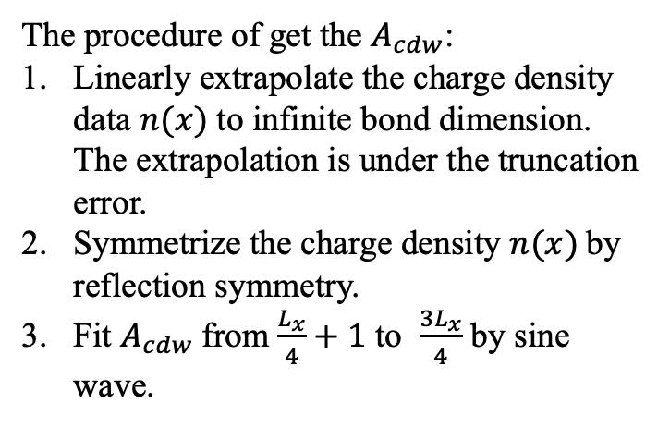

Fit $K_{c}$ from $A_{cdw}$
The procedure of get the $A_{cdw}$:
Linearly extrapolate the charge density data $n(x)$to infinite bond dimension. The extrapolation is under the truncation error.
Symmetrize the charge density $n(x)$by reflection symmetry.
Fit $A_{cdw}$from $\frac{L_{x}}{4}+1$ to $\frac{{3L}_{x}}{4}$ by sine wave.
$$\frac{1}{0. 71415}=1.400$$

Slide 17
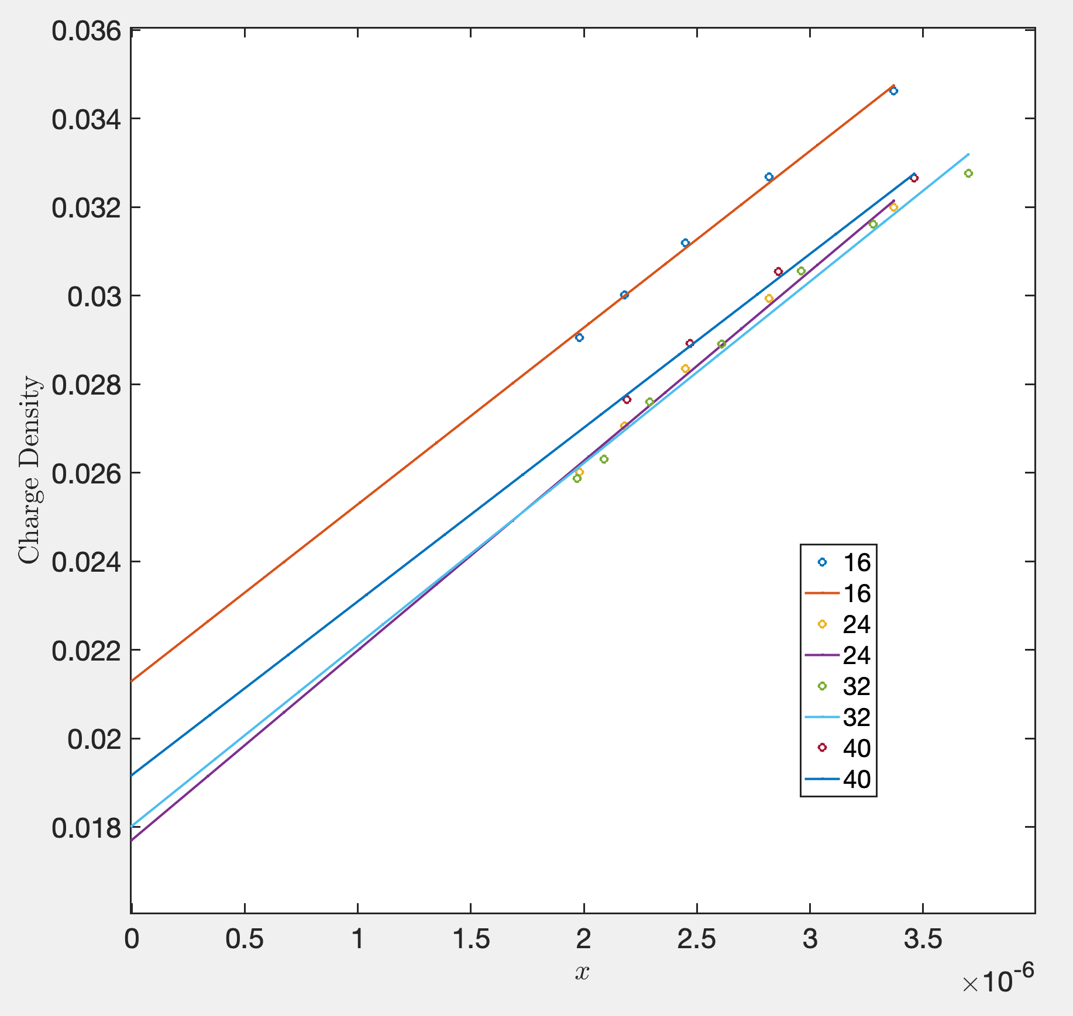
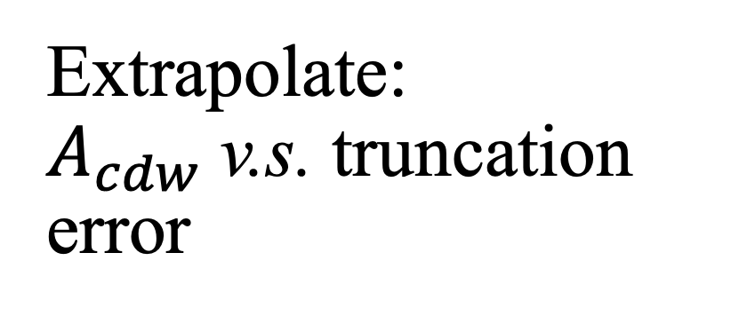
Extrapolate: $A_{cdw}$v.s. truncation error

Slide 18
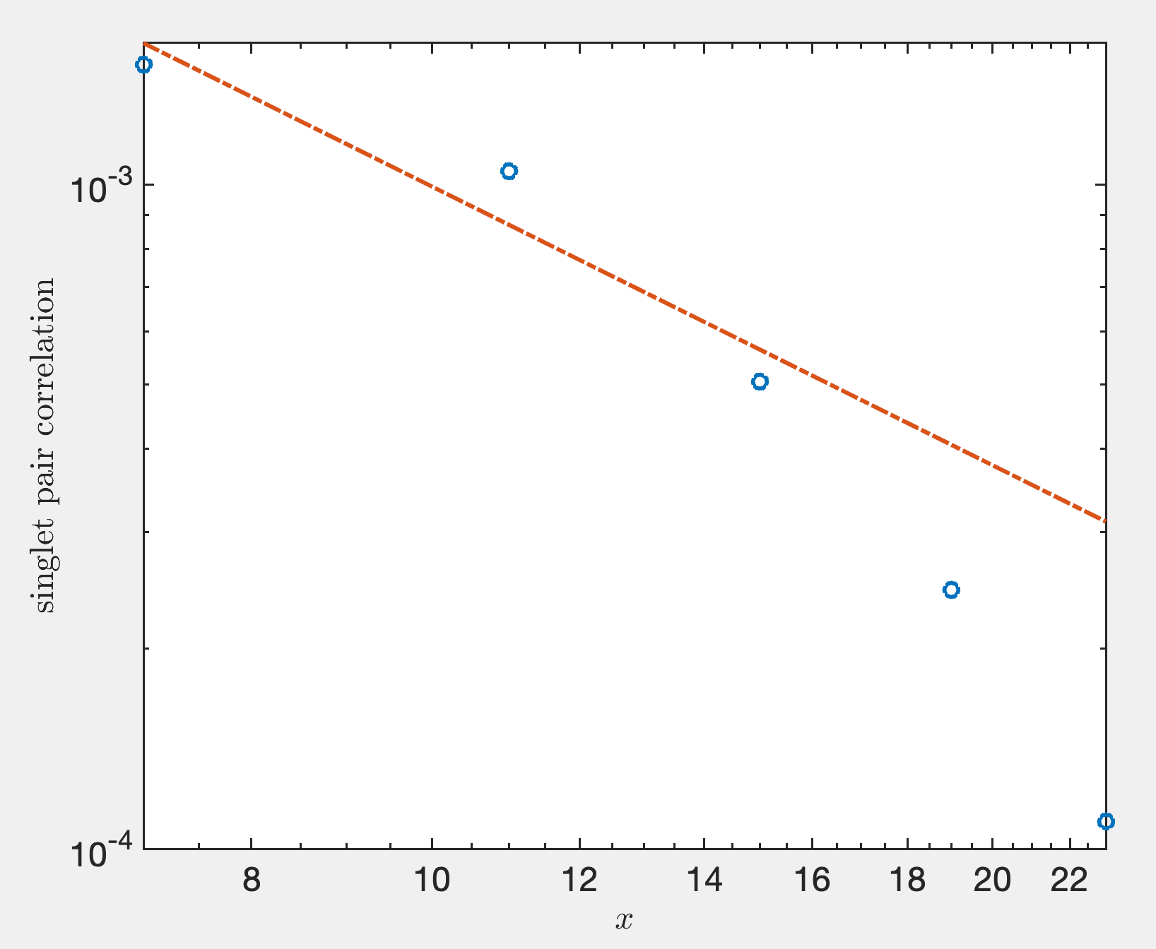
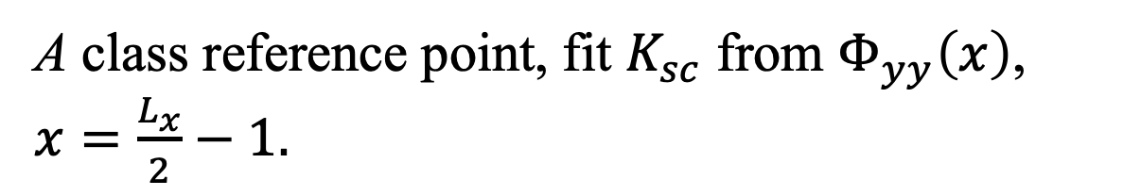
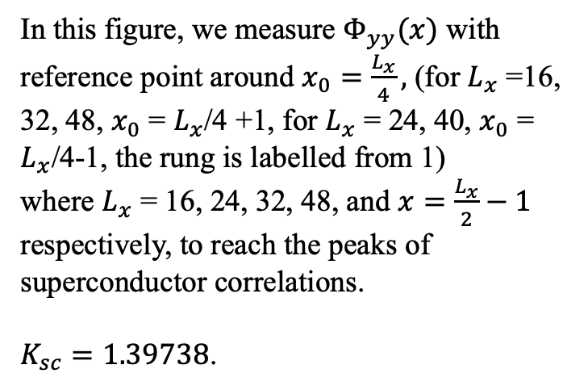
A class reference point, fit $K_{sc}$ from $Φ_{yy}\left(x\right)$, $x=\frac{L_{x}}{2}−1.$
In this figure, we measure $Φ_{yy}(x)$ with reference point around $x_{0}=\frac{L_{x}}{4},$ (for $L_{x}$ =16, 32, 48, $x_{0}$ = $L_{x}$/4 +1, for $L_{x}$ = 24, 40, $x_{0}$ = $L_{x}$/4-1, the rung is labelled from 1)
where $L_{x}$ = 16, 24, 32, 48, and $x=\frac{L_{x}}{2}−1$ respectively, to reach the peaks of superconductor correlations.
$K_{sc}=1.39738$.

Slide 19
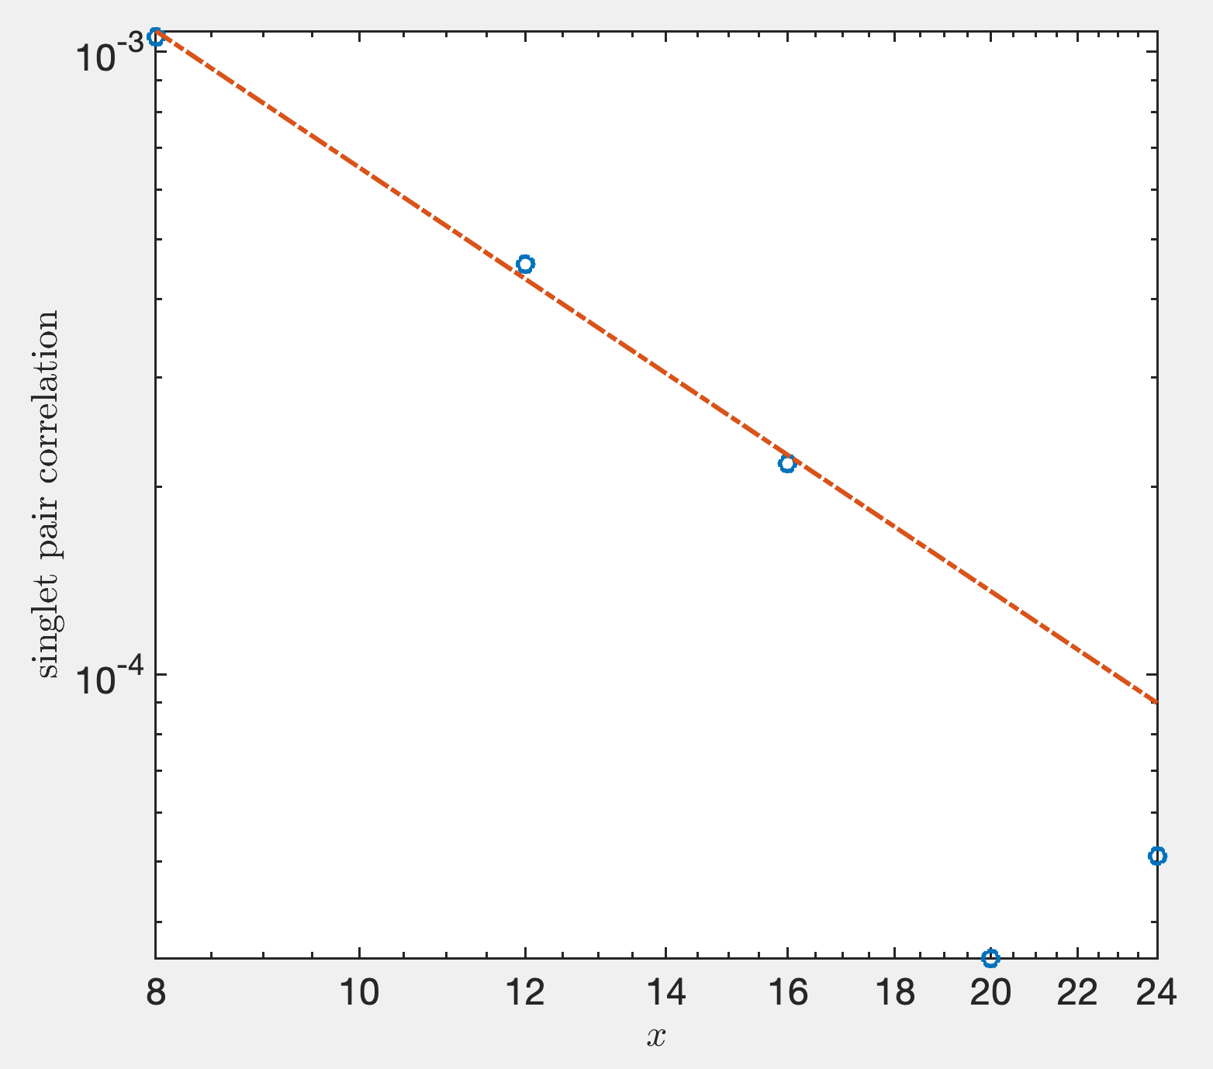
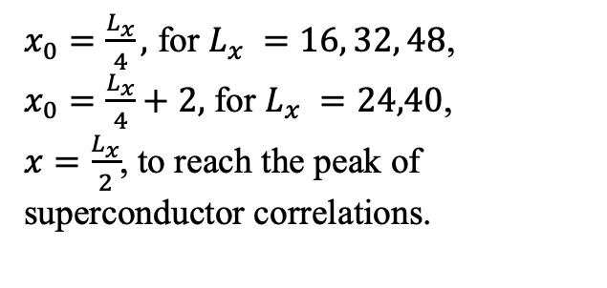
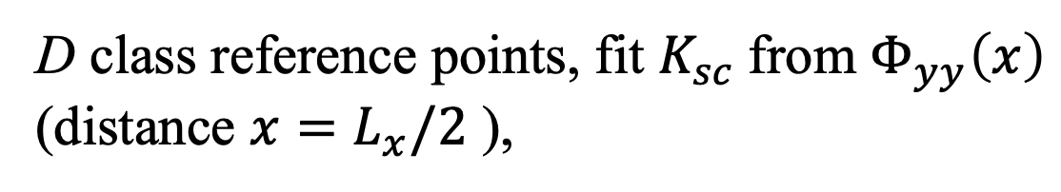
D class reference points, fit $K_{sc}$from $Φ_{yy}\left(x\right)$ (distance $x=L_{x}/2$ ),
$x_{0}=\frac{L_{x}}{4},$ for $L_{x} =16, 32, 48$,
$x_{0}=\frac{L_{x}}{4}+2,$ for $L_{x} =24,40$,
$x=\frac{L_{x}}{2}$, to reach the peak of superconductor correlations.
$$K_{sc}=2.26$$

Slide 20
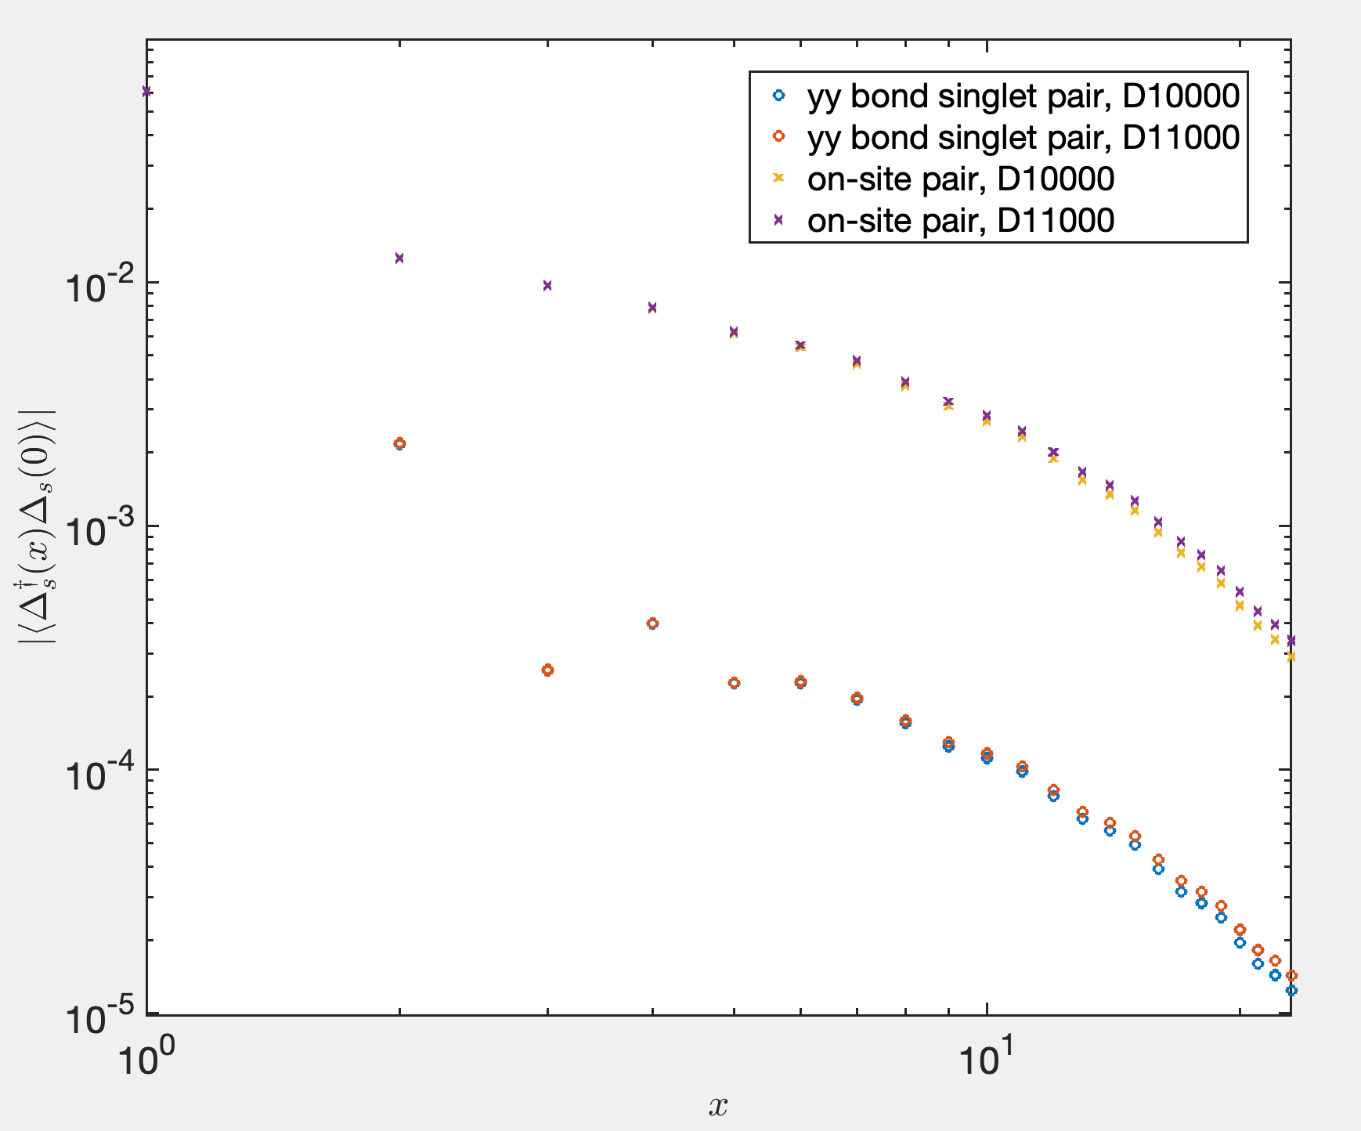
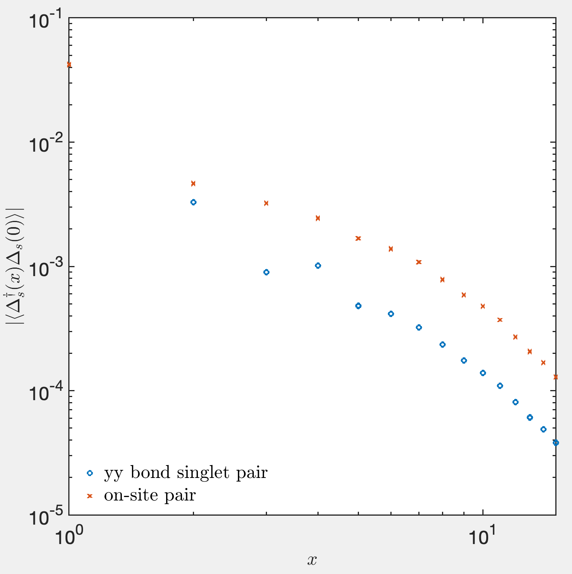
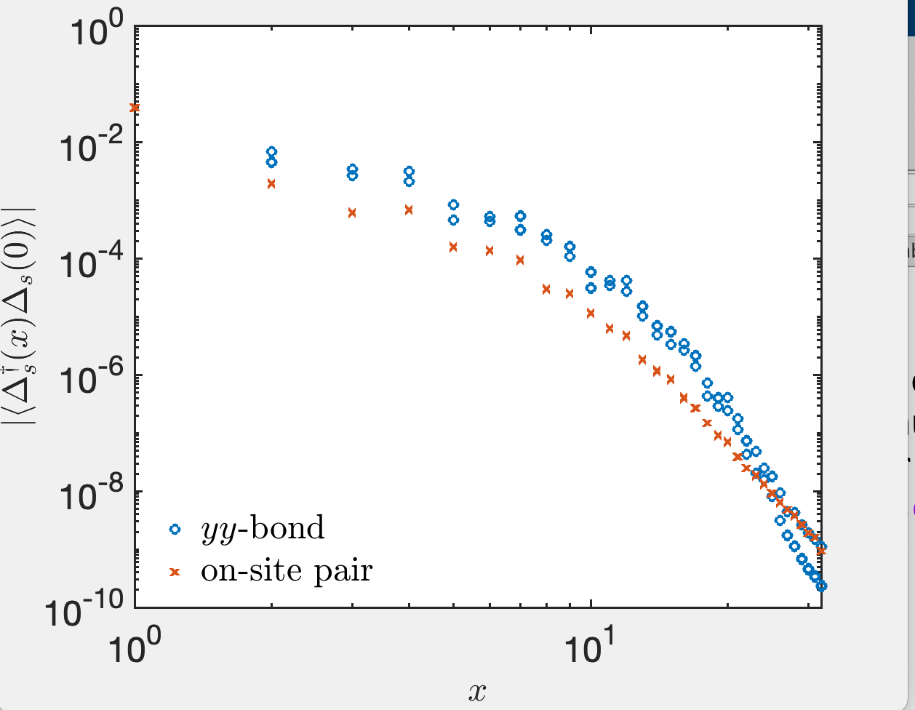
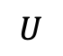
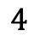
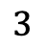
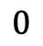
$λ=0.3, L_{x}=48, D=8000$, compare s-wave and d-wave
(although wave functions are not converged)
$$U$$
$$0$$
$$3$$
$$4$$

Slide 21
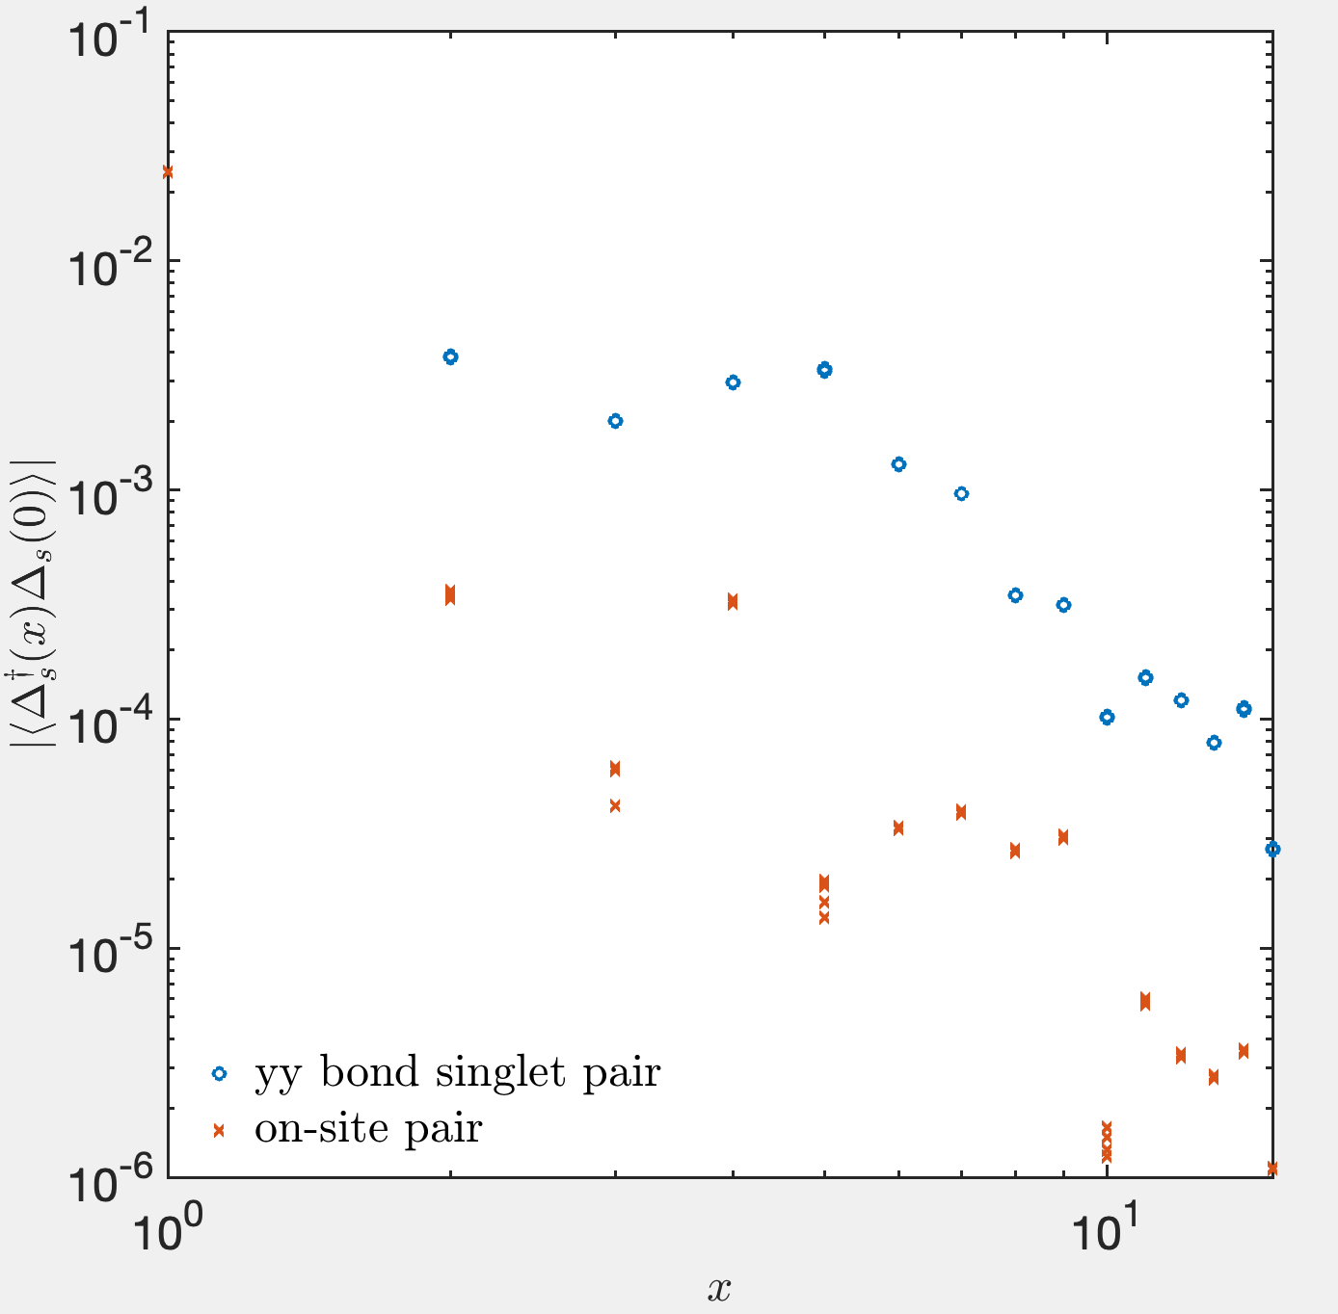





$λ=0.05, L_{x}=32, D=8000$, compare s-wave and d-wave
$$U$$
$$0$$
$$0.05$$
$$1$$
$$2$$

Slide 22







Charge density profile and reference point when measuring
$$L_{x}=16$$
$$L_{x}=24$$
$$L_{x}=32$$
8
4
8
$$L_{x}=48$$
12

Slide 23
4 class Reference points when measuring
D
A
B
C

Slide 24




Compare correlations on different reference points
$$λ=0.3, U=8, D = 8000, L_{x}=32$$
$$\frac{L_{x}}{2}$$
shift $π/4$ to right
B-> A -> D (->C)

Slide 25

Landscape: 3-leg ladder, $δ=1/8$

Slide 26


Plaquette d-wave versus Ordinary d-wave
Plaquette d-wave
$Φ_{yy}^{′} =−Φ_{yy}<0$
$\left|Φ_{xy}\right|$ decays exponentially, whatever the signs.
Ordinary d-wave
$Φ_{yy}^{′} =Φ_{yy}>0$
$Φ_{xy}$decays in power law, and has negative values. It’s better $Φ_{xy}=−Φ_{yy}$, otherwise there are some s-wave components.

Slide 27





Discussion for the Plaquette d-wave
t’
https://journals.aps.org/prb/pdf/10.1103/PhysRevB.102.041106
t’’

Slide 28
Discussion for the Plaquette d-wave
t’ -SSH
https://journals.aps.org/prb/pdf/10.1103/PhysRevB.102.041106
t’’ – SSH phonon only in y-bond

Slide 29


SSH phonons only living in y-bonds: plaquette d-wave state
Recall the White’s argument about the effect of negative $t’$in 4-leg cylinders states that $t’$on the surface actually suppress the d-wave pairing on surface and thus induce d-wave pairing in plaquette, which can be verified by $t’’$on plaquette that has opposite effect on the pairing symmetries. The argument implies competition relation between the plaquette and ordinary d-wave pairing symmetries. We imitate the argument in the following ways. If EPC living on the surface suppresses the ordinary d-wave pairing on surface, the EPC only existing on plaquette would suppress the d-wave pairing on plaquette then at least enhance the d-wave pairing on surface. However, a simulation of the Hubbard model with additional SSH phonons living only on y-direction bonds shows that the ground state has stronger plaquette d-wave order than the original SSHH model, as shown in the figure. Consequently, the White’s argument fails here.
The fact that the SSHH model has weaker plaquette d-wave SC order than the model with only y-bond phonons indicates that the EPC on surface actually suppress the plaquette d-wave pairing. Moreover, the origin of the plaquette should be the non-symmetric geometry of the lattice but not the EPC. EPC plays the role of inducing pairing on bonds either with or without phonon on x-bonds. Our calculations also suggest the d-wave pairing symmetry has more competitive than the extended s–wave pairing. Further calculations based on Eliashberg theory can justify such opinions.
D=6000

Slide 30


SSH phonon living in NNN in plaquette plane ordinary d-wave state
D=6000

Slide 31

Plaquette
Ordinary
Plaquette
May not SC
Plaquette
Plaquette
Ordinary
Ordinary (Possibly mixed)
Ordinary
Ordinary
Plaquette d-wave
Maybe filled-stripe
Plaquette
Plaquette
Ordinary (Possibly mixed)
Ordinary (Possibly mixed)

Slide 32












More detail for the d-wave phase
Charge density profile (Finite bond dimension)
$$U=1.5, λ=0.1$$
$$U=1, λ=0.05$$
$$U=2 λ=0.05$$
$$U=3, λ=0.2$$
$$U=4, λ=0.3$$
$$U=6, λ=0.3$$

Slide 33





d-wave pairing in the small interaction region: possible mix ordinary and plaquette d-wave
$$U=2, λ=0.05,D=9000$$
$$U=1.5, λ=0.1, D=10000$$
$$U=1, λ=0.05, D=12000$$

Slide 34


If we increase the bond dimension (from D=10000, purple, to D=12000, orange), how the data evolve.
Ordinary d-wave component enhances.
$$U=1.5, λ=0.1$$

Slide 35





Plaquette d-wave state
$$U=3, λ=0.2,D=8000$$
$$U=6, λ=0.3,D=8000$$
$$U=8, λ=0.3,D=∞$$
$${(K}_{sc}=0.94 in this extrapolation)$$

Slide 36












Ordinary d-wave components in s-wave phase
$$U=0, λ=0.05,D=8000$$
$$U=0.5, λ=0.1,D=8000$$
$$U=2, λ=0.2,D=8000$$
$$U=3, λ=0.3,D=8000$$

Slide 37


Plaquette d-wave components in CDW phase
$$U=8, λ=0.05,D=16000$$

Slide 38

Open boundary in 4-leg ladder

